Slide 1
Mechanical fault diagnosis and prediction in IoT based on multisource
sensing data fusion
Sankalp Agrawal

Slide 2
Overview
Using multi-source sensing data based on the Internet of Things (IoT) with artificial intelligence and big data processing technology to achieve the goal of predictive maintenance.
This paper discusses multi-source sensing data fusion models.
various types of fusion algorithms based on Neural Networks and Deep Learning, including Dempster-Shafer (D-S) evidence theory and their applications in mechanical fault diagnosis and fault prediction are discussed.

Slide 3
Since the development of data fusion technology, a variety of fusion models have been proposed, such as:
The JDL model
Boyd’s OODA (Observe-Orient-Decide-Act)
Loop model
Intelligence Cycle model
The Omnibus model
State Transition Data Fusion (STDF) model
Dasarathy model
Waterfall model
Hybrid model

Slide 4
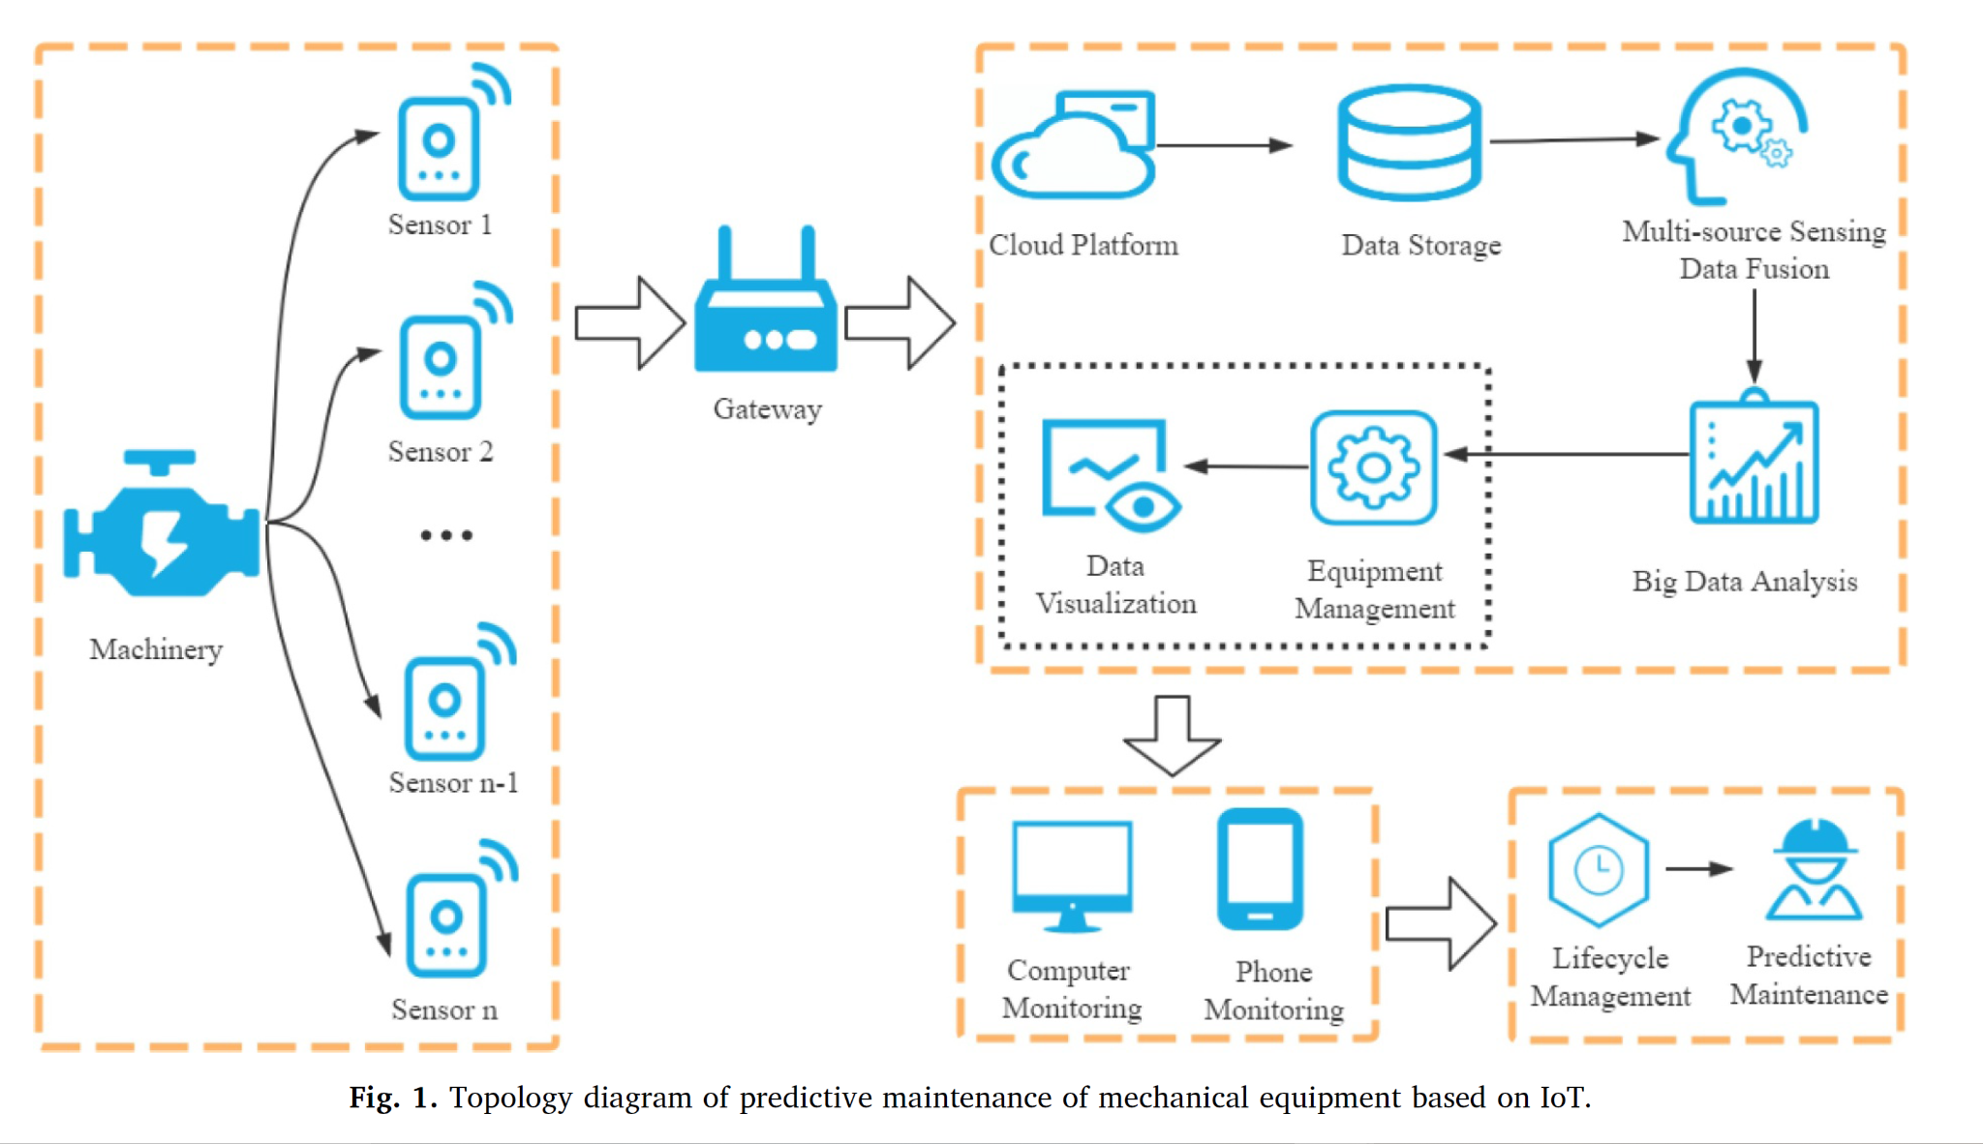

Slide 5
Existing research on multi-source sensing data fusion algorithms can be divided into studies focusing on simple processing algorithms:
probability-based algorithms
Bayesian theory
Bayesian networks
naive Bayes
non-naive Bayes
Bayesian inference
D-S evidence theory
preprocessing the original evidence
Improvement of combination rules
Combination of other algorithms

Slide 6
Fuzzy Logic based algorithms
fuzzy logic reasoning
fuzzy clustering algorithm
intuitionistic fuzzy set
combination of other algorithms
Artificial Intelligence Algorithms
Neural Networks
Back-Propagation Neural Network (BPNN)
Radial Basis Function Neural Network (RBFNN)
Elman Neural Network (ENN)
Support Vector Machines (SVM)
Deep Learning
Convolutional Neural Network (CNN)
Deep Belief Network (DBN)
Deep Neural Network (DNN)
Other algorithms
ant colony algorithm
genetic algorithm
Kalman filtering

Slide 7
Back-Propagation Neural Network (BPNN)
multiple hidden layers
transfer parameters from the output layer to the input layer are learned by the back-propagation algorithm.
Elman Neural Network(ENN)
Based on BPNN, ENN adds a feedback layer behind the hidden layer to provide the network with a memory function, which is a dynamic recurrent neural network.
Radial Basis Function Neural Network (RBFNN)
Structure of RBFNN is similar to that of BPNN, but with only three fixed layers, using a radial basis function as the neuron activation function.
Probabilistic Neural Network (PNN)
PNN adds a summation layer based on the RBFNN model.
The summation layer determines the number of neurons based on the total number of categories of input data.
Fuzzy Neural Network (FNN)
FNN is developed through the combination of fuzzy logic theory and neural network model, and the input and output data, as well as the weight coefficients in the learning process, are all fuzzy sets.

Slide 8
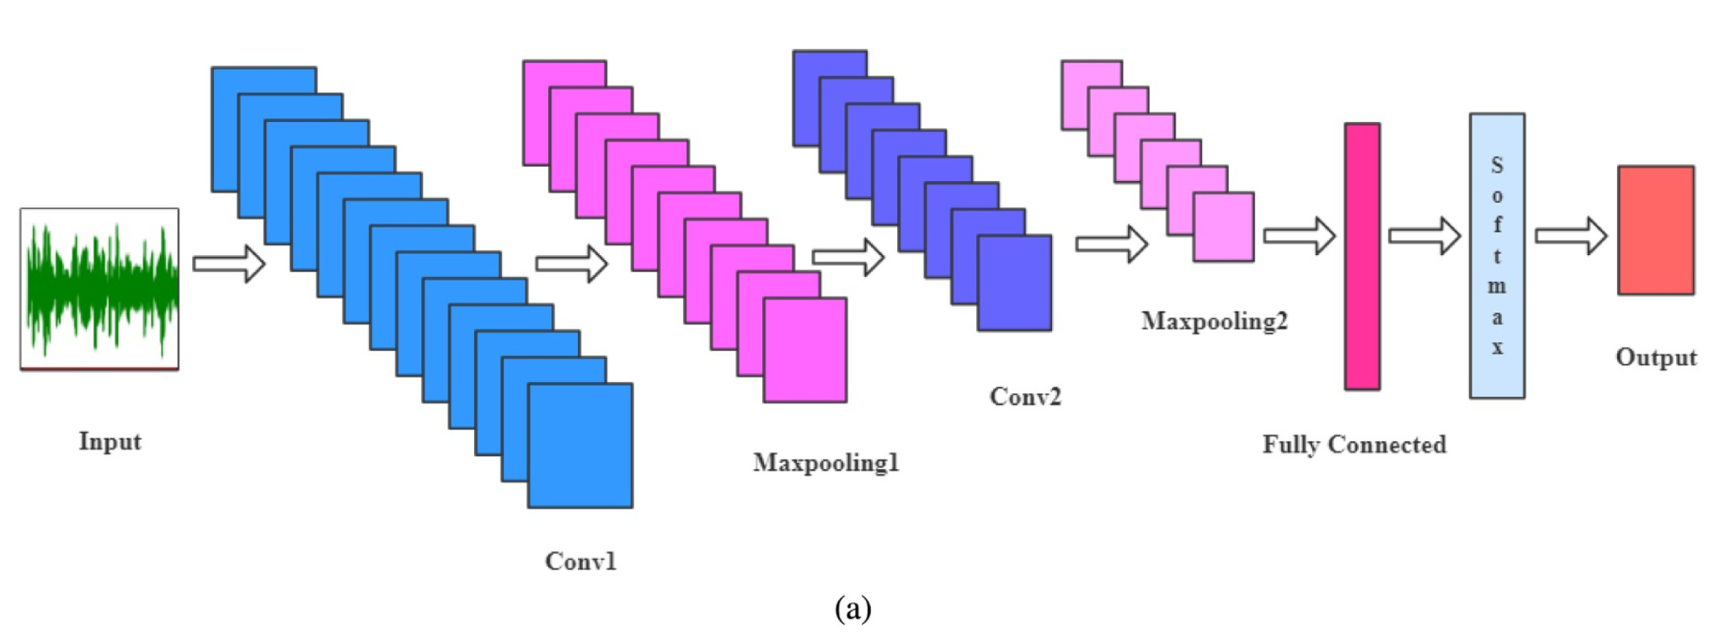
Convolutional Neural Network (CNN)

Slide 9
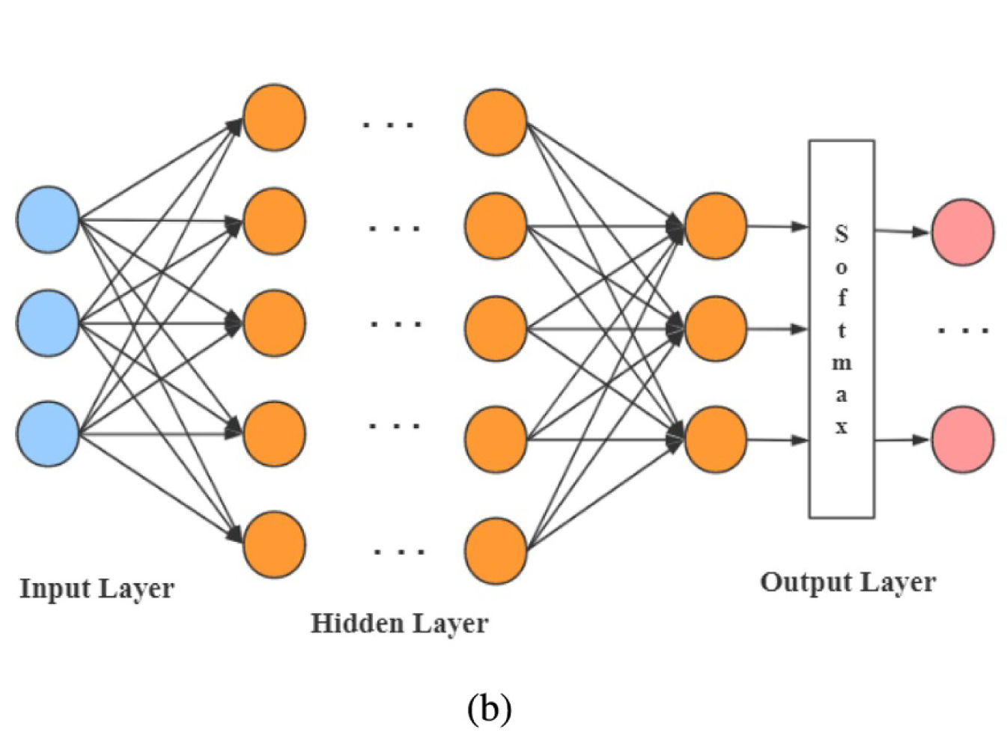
Deep Neural Network (DNN)

Slide 10
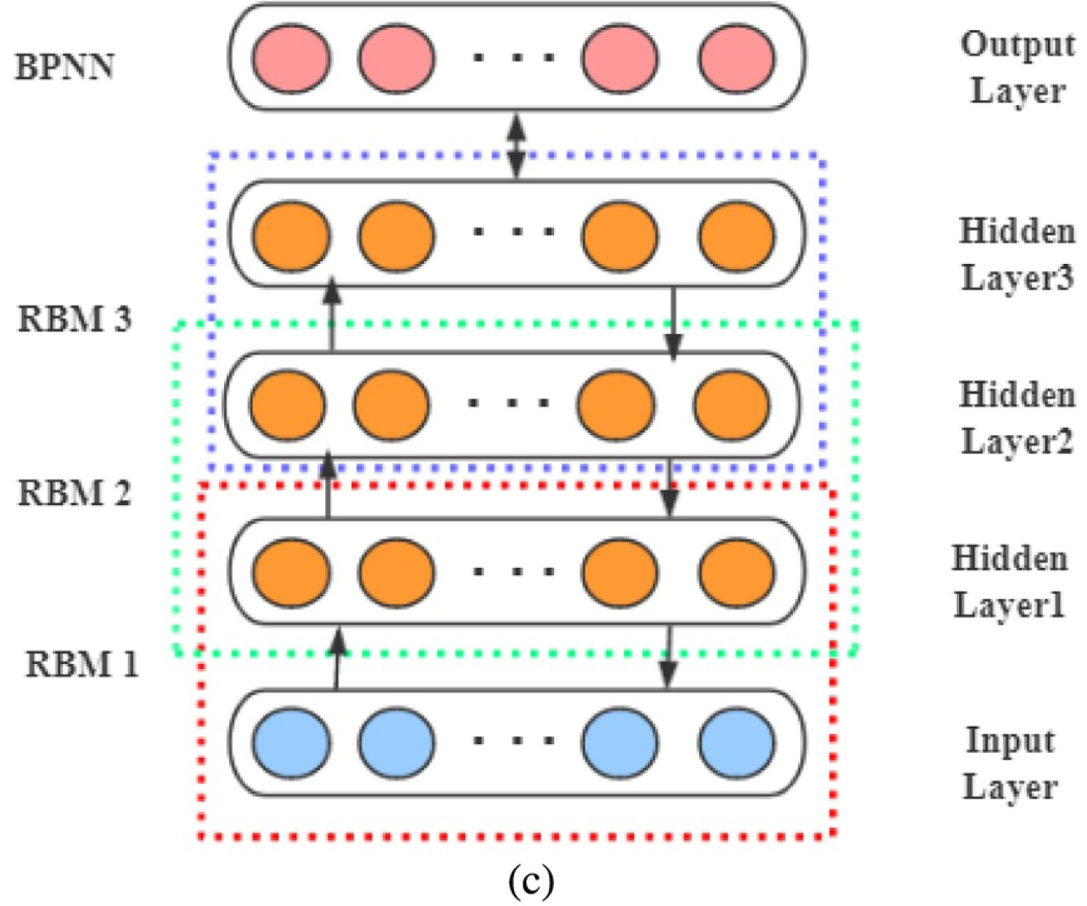
Deep Belief Network (DBN)

Slide 11
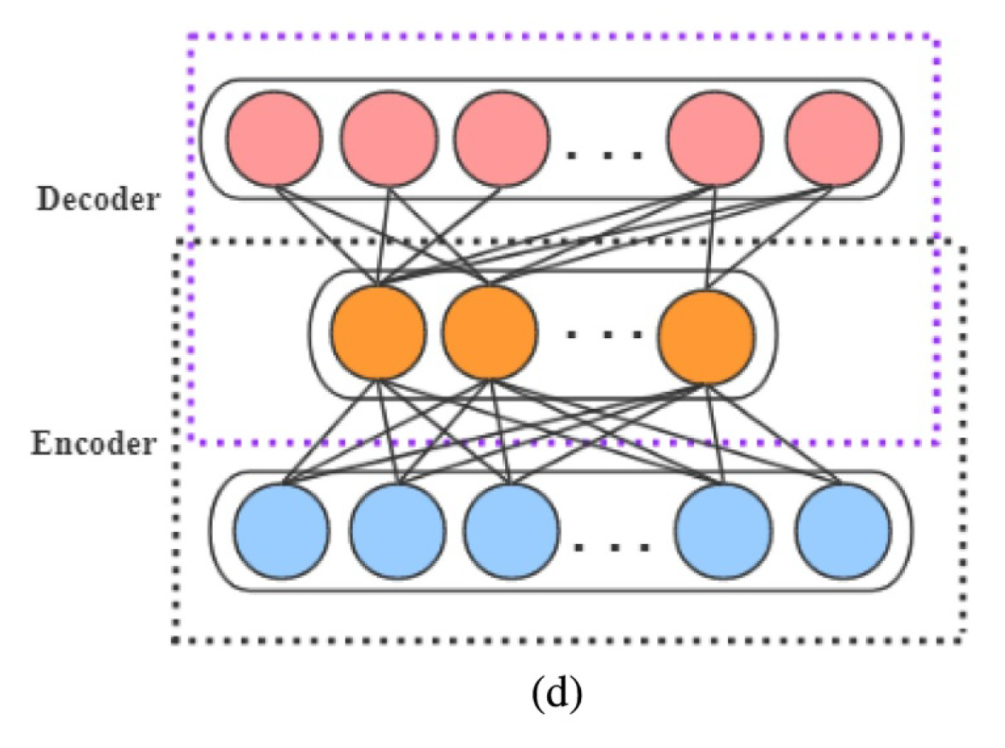
AutoEncoder (AE)

Slide 12
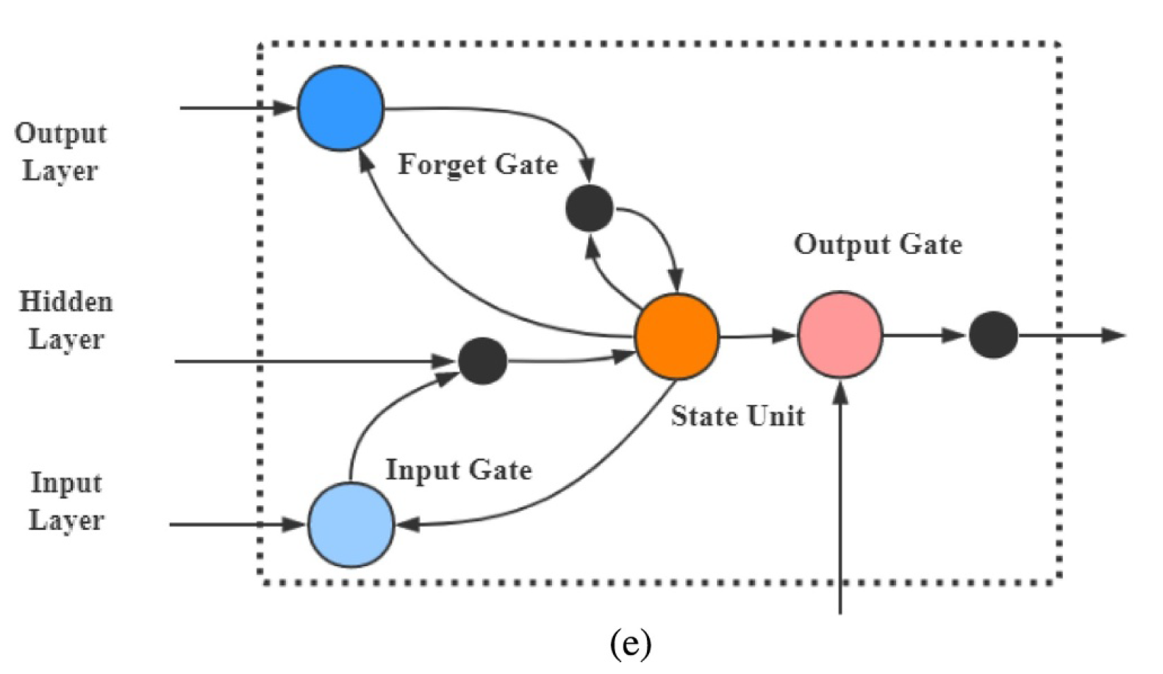
Long and Short-Term Memory network LSTM “CELL”

Slide 13
Case Western Reserve University (CWRU) Dataset Introduction
In different operating conditions of the bearing motor, CWRU Laboratory used multiple accelerometers to collect vibration data at different locations of the bearing motor, thus obtaining the Dataset.
The fault locations were separately at the inner raceway, rolling element and outer raceway of the bearing driving end or fan end.
The bearing rolling element was available in four different types of diameters, each representing a different type of fault.
There were 4 different load types and 4 different speeds of bearing motor, respectively representing the fault of the bearing motor under different conditions.

Slide 14
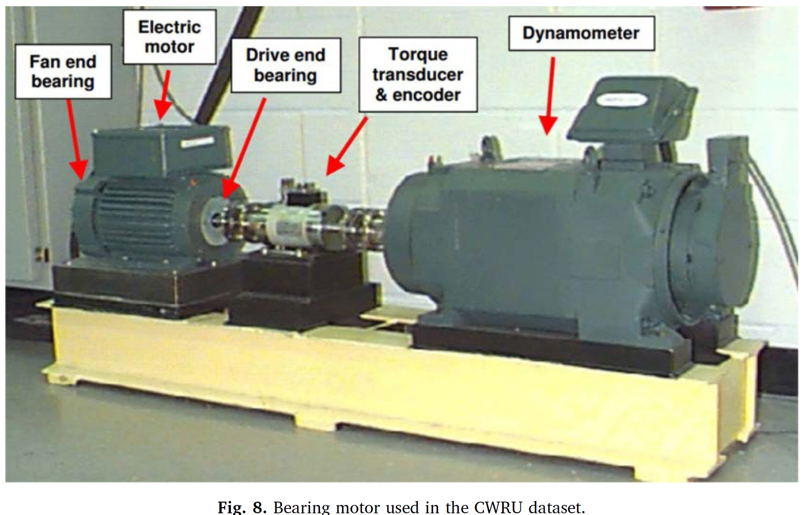

Slide 15
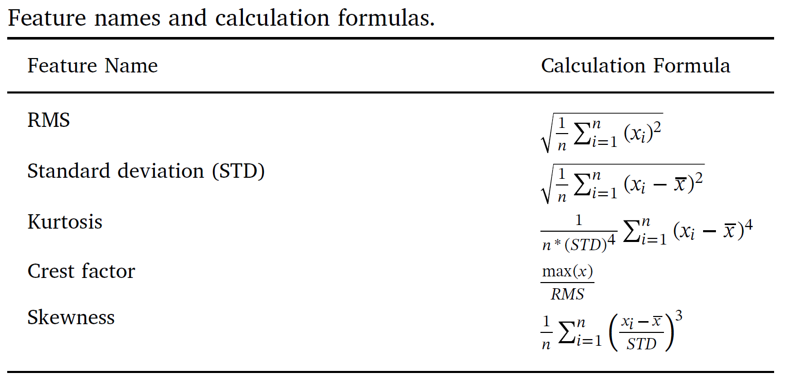
Experimental content and simulation results:
four eigenvalues of Root Mean Square (RMS), Kurtosis, Crest factor and skewness were selected for fault diagnosis and prediction.

Slide 16
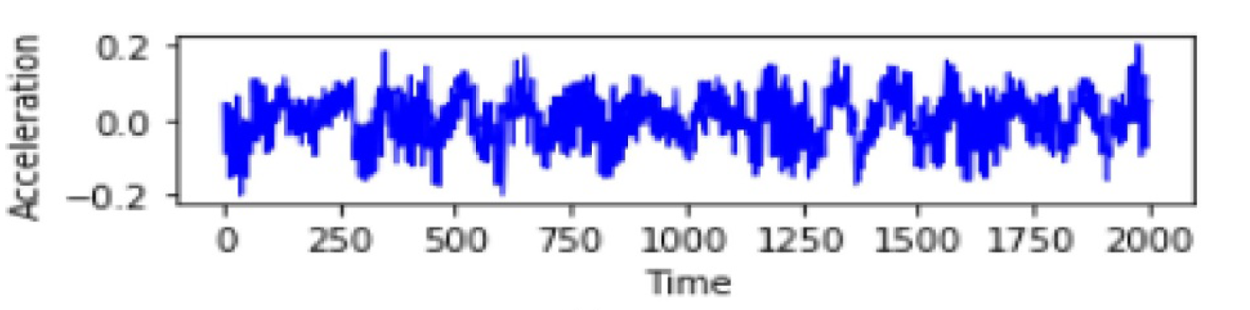
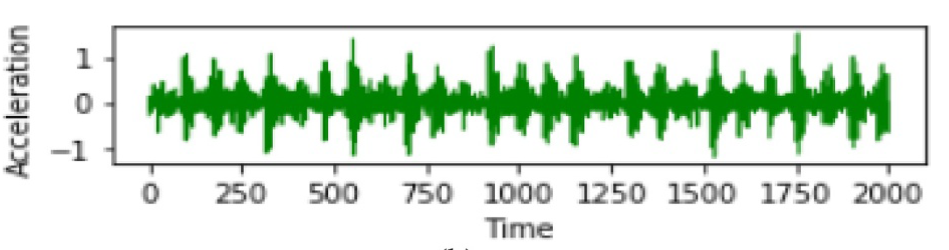
The conditions for collecting normal state data was that the Motor Load value was 1 hp and the speed value was 1772 rpm. The fault data acquisition conditions were that the frequency value was 12000 sample/s and the fault diameter value was 0.007 in. .
The fault locations included three different parts in the drive end: the inner raceway, the outer raceway and the rolling raceway.
shows the change of vibration acceleration of the bearing driving end with time under normal and inner raceway fault conditions.
(a) normal conditions (b) inner raceway fault conditions

Slide 17
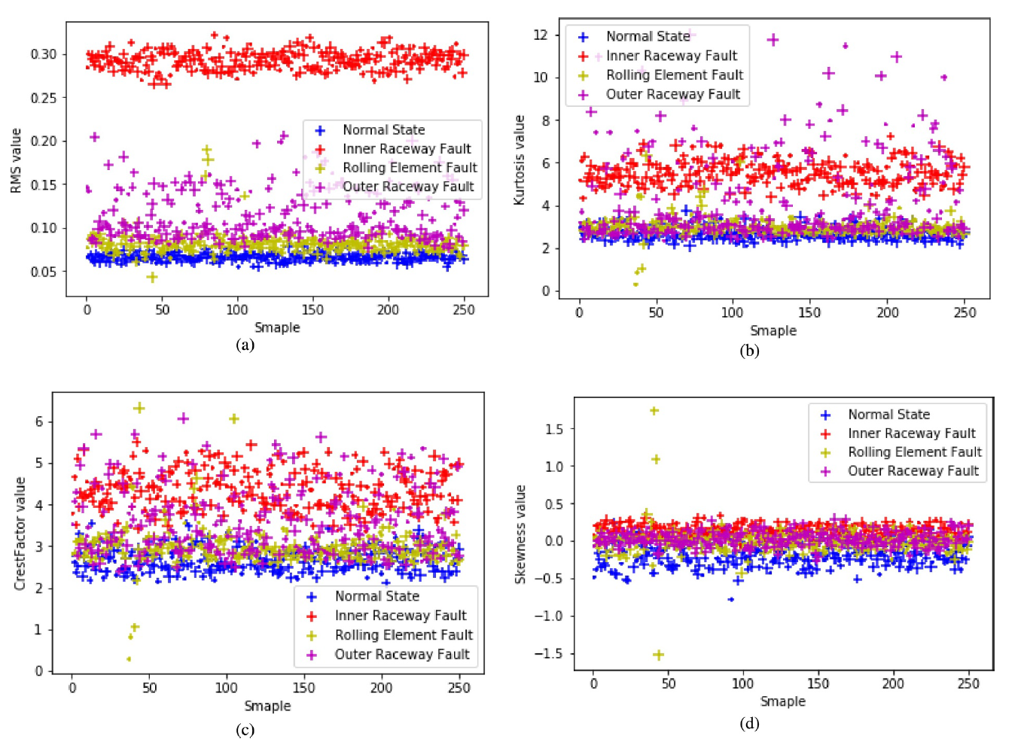
Feature extraction was performed using 480 consecutive sampling points. Each feature value was taken as 250 groups, and the order of feature values was randomly assigned.
It can be seen from the figure along that, in the normal state, the inner raceway fault, the outer raceway fault, and the rolling raceway fault
corresponding to the bearing have different characteristic values, and the degree of discrimination also differs.
(a) Root-mean-square value of all bearing signals
(b) Kurtosis value of all bearing signals
(c) Crest factor value of all bearing signals
(d) Skewness value of all bearing signals.

Slide 18
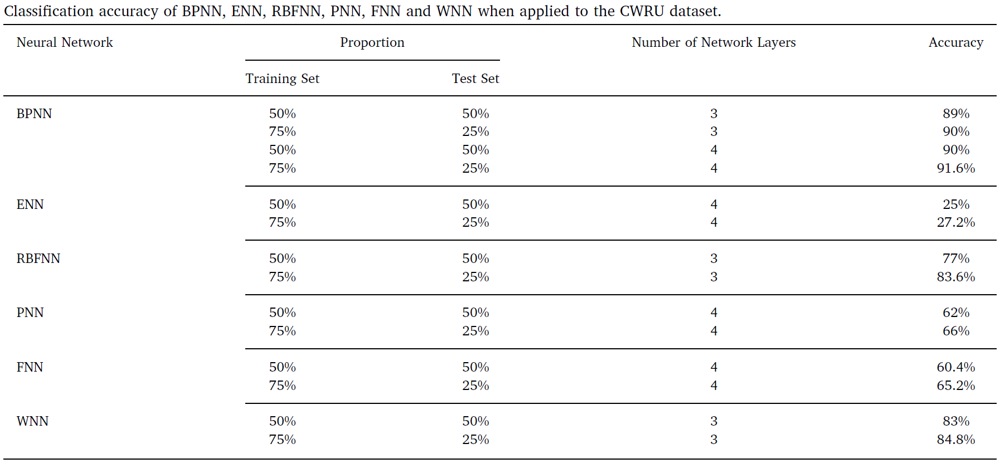

Slide 19
TURBOFAN DATASET
Dataset Used : FD001
Previous results :
Model Used : Linear Regression
RMSE : 39.58 ; R2_Score : 0.6697
Model Used : Decision Tree Regressor(criterion = ‘mse’, max_depth = 7, random_state = 1)
RMSE : 30.4126 ; R2_Score : 0.8050

Slide 20
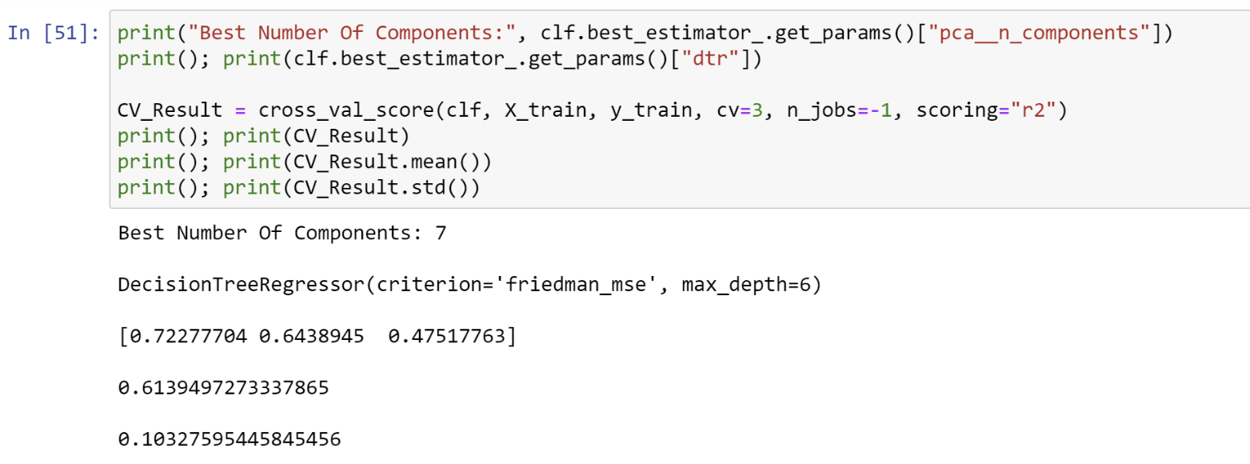
Using GridSearchCV, and PCA, I tried to reduce the dimensions of the dataset and optimise the parameter of Decision Tree Regressor.
The criterion to be chosen from by gridsearchCV were given by : ‘friedman_mse’ , ‘mse’ and ‘mae’.
PCA reduced the dimensions from 19 to 7 (which give the most variation in the dataset)
So the best number of components came out to be 7
With max_depth = 6
And criterion = ‘friedman_mse’

Slide 21
Increasing the depth of DecisionTreeRegressor increases the accuracy of the model but chances of overfitting also increases.
Training model with DecisionTreeRegressor(criterion='mse', max_depth=10) increase the accuracy from RMSE(old): 30.4126 to RMSE(new): 21.068 and
R2_Score(old): 0.8050 to R2_Score(new): 0.9064

Slide 22
The RMSE and R2_Score obtained after training the model which updated regressor were:
RMSE: 36.22 & R2_Score : 0.7234
The rise in RMSE & fall of R2_Score can be attributed to the fact that while performing PCA, we lost certain dataset which were very useful while calculating the accuracy.
Therefore, new model was selected for training the dataset.
New model : Random Forest Regressor

Slide 23
Model Used : RandomForestRegressor(n_estimators = 10, criterion='mse', max_depth = None)
RMSE and R2_Score obtained
RMSE : 7.3530 & R2_Score : 0.9886
With n_estimators = 100,
RMSE : 5.4838 & R2_Score : 0.9936

